Slide 1
Sheep 5
Leaving Certificate Agricultural Science
Sheep Housing & Wool

Slide 2
Sheep Housing & Handling
Winter Housing:
The provision of winter housing is important in intensive lowland sheep production.
In-wintering sheep rests pastures, prevents poaching and encourages early grass growth in spring.
It also makes management at lambing time easier.
Make feeding management easier.
Prevents chill and disease.
Prevents predators like foxes.
Reduces lamb and ewe mortality.
Sheep are normally housed in simple structures in small groups.

Slide 3
Sheep Housing & Handling - 2
Sheep Handling Unit:
A sheep handling unit is required in the farmyard by all sheep farmers.
It should contain a Collecting Pen, Storage Pens, a Footbath & Race and a Dipping Unit.
A collecting pen is used for collection and sorting of the flock.
Storage pens are used to shear the sheep, have their feet pared and treated for worms etc.

Slide 4
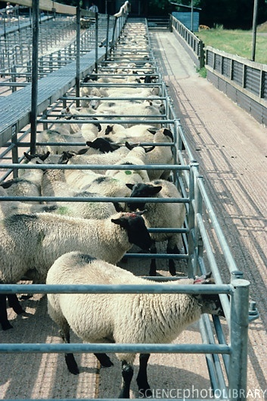
Sheep Housing & Handling
The foot bath & race is obviously for foot-bathing to treat foot rot.
And the Dipping Unit is used to administer the summer and winter dip.

Slide 5
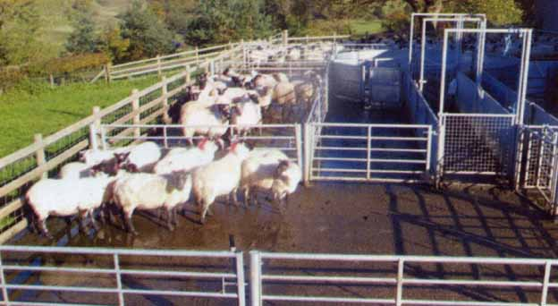

Slide 6
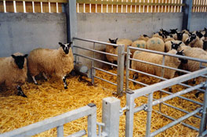
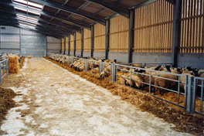
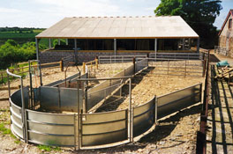

Slide 7
Wool Production & Quality
Wool fibres are modified epidermal cells.
Wool fleece yields vary between 2kg and 4kg each year and contains hairs (kemps) and wool fibres.
Wool fibres are solid while kemps are hollow.
Ewes, hoggets and withers (castrated males) are shorn whereas lambs destined for slaughter are not.
Shearing normally takes place in June.
Wool Quality is determined by how fine the wool fibre is.
Most wool fibres in Britain and Ireland are between 40 – 50 μm.
Merino Wool is only 15 μm.

Slide 8
The Bradford Scale
The Bradford Scale is used to measure wool quality.
It is defined as:
The number of hanks of yarn, each 510m long, that can be spun from 450g of wool prepared for spinning!
Don’t worry about it.
Know that anything over a Bradford Scaleof 60 is defined as Merino, between 40 & 58 is Crossbred and below 40 is Carpet!
Merino wool is used for top quality wool products. Crossbred wool is used for tweed and carpet, well for carpet!

Slide 9
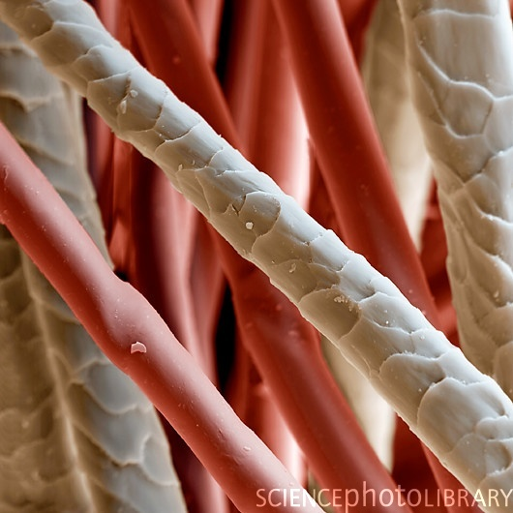

Slide 10
