Slide 1
Sheep 3
Leaving Certificate Agricultural Science
Lamb Care & Finishing

Slide 2
Lambing
The gestation period of the sheep is 147 days (5 months less five days).
The birth weight should be 5 kg’s for single and 3.5 kg’s for twins.
As ewes approach lambing, they become restless and often lie on the ground scratching themselves.
They should not be interfered with if possible at this stage but it is advisable to coax them into a lambing pen or jug!
What are the advantages of a pen?

Slide 3
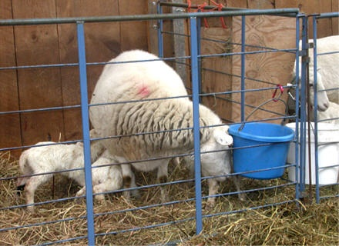

Slide 4
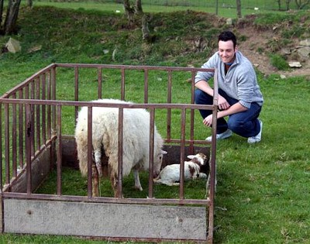

Slide 5
Lambing - 2
In the pen the ewes can be watched at all times and any lambing problems dealt with.
Before birth, the water bag should show clearly. This means birth is about an hour away.
If birth does not happen an hour after the water bag has shown, then the lamb probably is in an abnormal position in the uterus (womb)
The normal order of birth is head first, with the chin resting on the forelegs i.e. the forelegs first
The lamb may be pushed in if this position is not seen at the initial stage.

Slide 6
Lamb Care After Birth
Immediately after birth, the nose and mouth of the lamb is cleared from mucus. Why?
The naval is cut or carefully pulled to a length of 7 – 10 cm and then dipped in iodine or another disinfectant.
The ewe will usually lick the lamb clean and dry.
This actually stimulates blood circulation in the lamb and warms it up.
If the ewe does not lick the lamb, then the farmer or vet should rub the lamb with clean straw.
A heater is often needed in a lambing pen.

Slide 7
Lamb Care After Birth - 2
It is very important that the lamb drinks as soon as possible.
The importance of colostrum must be stressed. (Ewe or stomach tube)
If there is no milk, then colostrum from another freshly lambed ewe can be used or cow’s colostrums.
Cow’s colostrum can be frozen and stored for emergencies.
After the birth of the lamb (about two hours) the after birth should arrive.

Slide 8
Lamb Care After Birth - 3
This is the placenta, which provides the connection between mother and off spring in the womb.
Lambs should be left with their mothers in individual lambing pens until properly “mothered on”.
This usually takes about three days then they can be put together with the other newly lambed sheep.

Slide 9
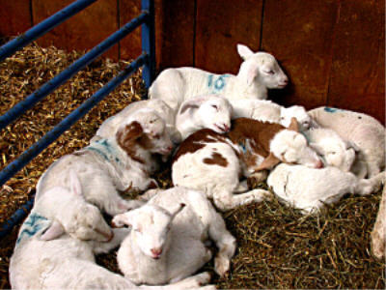

Slide 10
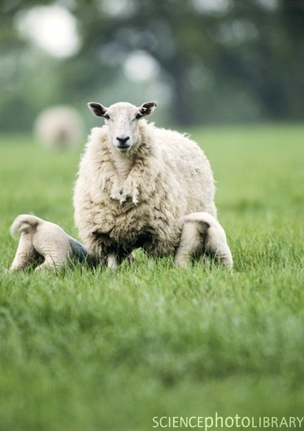

Slide 11
First Weeks After Lambing
Tail docking is carried out in the first week of the lamb’s life.
This involves removing the lamb’s tail.
All lowland sheep have their tails docked / removed but some farmers just remove the ewe’s tails only.
In addition, all ram lambs not intended for breeding are CASTRATED.
Castration and tail docking are performed with the same tool – the “elastrator”.

Slide 12
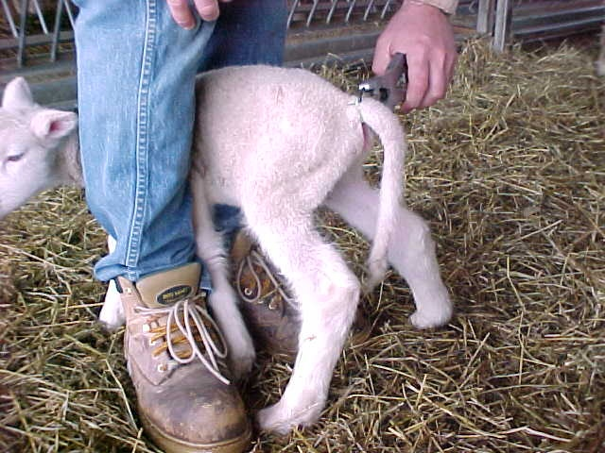

Slide 13
First Weeks After Lambing - 2
This tool stretches a special strong rubber ring so that it can be placed around the tail or the scrotum!
This stops circulation in those areas and they eventually just fall off!!!
In this time (after lambing) the ewe’s appetite also increases dramatically and she drinks a lot of water.
Concentrates should be used until good grass is available for the lactating ewe.
Then precautions should be taken when on good grass against grass tetany.
Grass tetany is caused by low Mg levels in the grass.

Slide 14
Weaning the Lamb off Milk
Lambs are weaned at 12 – 14 weeks old unless already sold for slaughter!
They should be dosed before moving onto fresh pasture, and then every three to six weeks.
The lambs should be kept on clean / good quality pasture all the time.
The ewe is placed on poor pasture. Why?
So that they are “dried up” and so that they will not be too fat when flushed the following year.
Vaccination of the lambs should take place regularly against clostridial diseases. (Initially after 6 weeks and then every six weeks)
Creep feeding should be used to feed the lambs.

Slide 15
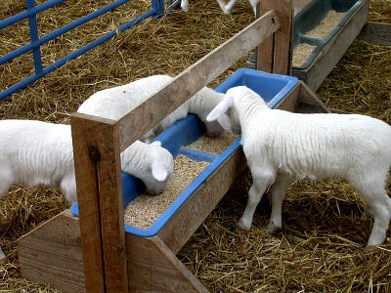

Slide 16
What is Creep Feeding?
By the time the lambs are 10 days old, they will have access to a creep area for creep feeding.
A creep is a pen that is fenced so that young animals can enter but adults cannot.
Creep feed is feed given to young nursing lambs.
The lambs will also have access to fresh water, high quality hay, and minerals in the creep area.
This allows for the lambs to get the all the food they need but still have access to their mother if not properly weaned.

Slide 17
Shearing & Summer Dip
Lowland sheep are shorn before the end of May.
If wool production is important to the farmer, then particular attention is given to the date of shearing and the shearing is done when the wool rises (weather dependant)
Sheep should not be sheared if their stomachs are over full or when they are in heat.

Slide 18
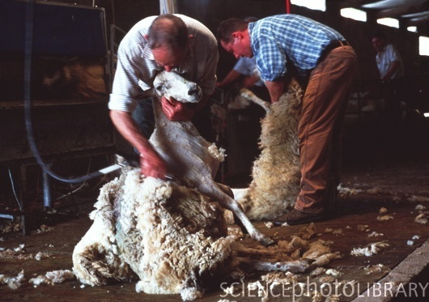

Slide 19
Shearing & Summer Dip
Two weeks after shearing the sheep receive their summer dip.
This is to prevent “fly strike”.
This refers to the blowfly or the green bottle fly, which lays its eggs in the fleece and maggots grow quickly.
Six months after lambing the booster injection against clostridial diseases is administered.

