Slide 1
Sheep 4
Leaving Certificate Agricultural Science
Sheep Diseases

Slide 2
Sheep Diseases
As species, sheep are much better adapted to life on hills (their natural habitat).
Therefore, keeping them on lowland farms causes health conditions that would not otherwise arise.
Specifically, lowland sheep suffer more from maggots, internal parasites and footrot.
The main reasons these conditions arise on lowland flocks are climate and stocking rate.

Slide 3
Sheep Diseases - 2
Maggots are prevented on hills because the harsh conditions simply do not allow them to thrive.
Footrot is controlled on farms because sheep’s hooves are naturally stronger due to more use and wear.
Maggots / Fly Strike
Maggots are the larvae (young) of the blowfly or the Green Bottle Fly.
The fly is attracted to odours in the fleece, and they lay their eggs on dung–soiled wool.

Slide 4
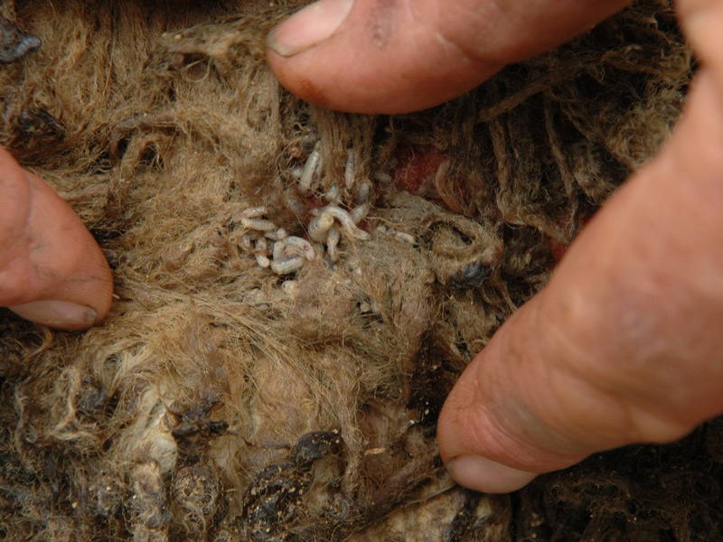

Slide 5
Sheep Diseases - 3
Fly strike can be prevented by
Dipping in the Summer
Trimming excess wool around the tail
Tail docking
Grazing management (to prevent scour)
An affected sheep is usually quite restless and scratches the affected area frequently.
The area may appear green and wet.
Maggots should not be ignored and can often be fatal!

Slide 6
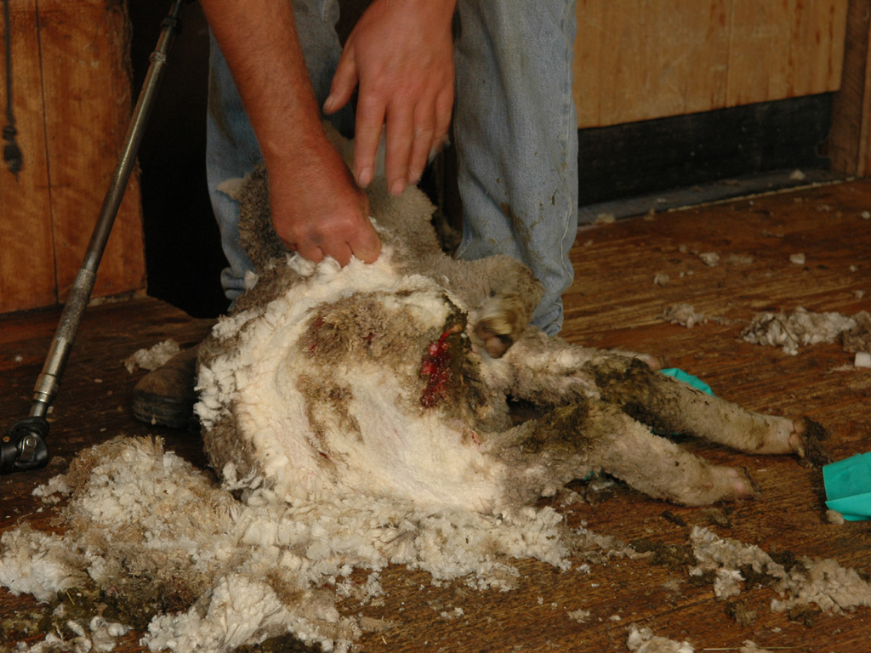

Slide 7
Sheep Diseases - 4
Worms
Nearly all sheep carry intestinal parasites / worms.
The older / more mature the animal the less worms.
This is because older animals develop a certain immunity to worms.
Worms can only be controlled effectively with both drugs and good pasture management.
All sheep should be dosed regularly and pastures managed as to prevent the spread of worms.

Slide 8
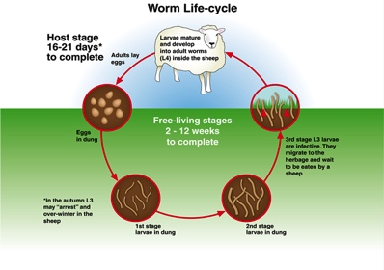

Slide 9
Sheep Diseases - 5
Liver Fluke
This is a “flat worm” which can cause death to sheep or simply reduce thriftiness and lower the quality of the carcase.
Both worms and liver fluke cannot reproduce inside the sheep (host) so the number of larvae eaten determine the extent of the disease.

Slide 10
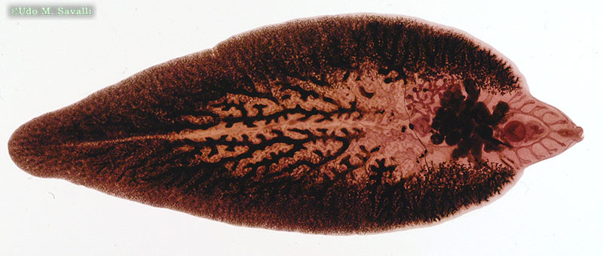

Slide 11
Sheep Diseases - 6
Footrot
Footrot is a very serious problem on Irish Farms.
Footrot is caused by a bacteria, in fact many different types of bacteria.
Footrot causes lameness, serious pain, reduced food intake, in-activity and can lower fertility in rams.
You can spot an affected sheep by seeing them kneeling down while grazing.

Slide 12
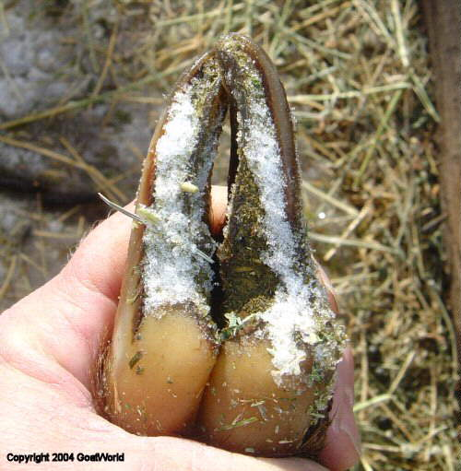

Slide 13
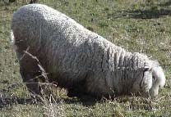

Slide 14
Sheep Disease - 7
Swayback
A deficiency disease caused by low levels of copper in the diet.
Affected animals are unable to stand or coordinate their legs properly.
Anaemia
A deficiency disease caused by a lack of iron in the diet.

Slide 15
