Slide 1
Sheep 2
Leaving Certificate Agricultural Science
Breeding Principles & Practices

Slide 2
Hill Farming Breeding Policy
On hill farms the harsh conditions mean only hardy breeds will survive.
These breeds, and the conditions, mean that most ewe sonly have one lamb per year.
Pure bred hill breeds (eg. Blackface or Cheviot) will be crossed with a pure bred ram of the same breed.
Cross bred ewes or lambs may not be able to survive in the harsh conditions.

Slide 3
Lowland Sheep Breeding Policy
On lowland farms, the aim is to produce twins or triplets from most ewes.
A ‘three-breed’ strategy is often employed.
First a prolific breed is crossed with a ewe breed to produce a hybrid ewe.
This ewe will produce lots of lambs but also be a ‘good mother’ (produce enough milk and not care for its lambs).
This hybrid ewe is then crossed with a carcass breed (terminal sire) to produce large muscular lambs.

Slide 4
The Breeding Season
On hill and lowland farms the breeding season begins in the autumn.
The gestation period of sheep is 5 months (less 5 days) meaning lambing takes place in the spring.

Slide 5
Early Lamb Production
On lowland farms some farmers breed out of the normal season, thus providing spring lamb for the Easter market.
This process involves ‘sponging’ – artificially bringing sheep into oestrous out of season.

Slide 6
Early vs Mid Season Lambing

Slide 7
Stock Selection - Ewes
From the existing flock ewes should be replaced if they are not suitable for breeding. These include:
Age
Udder troubles (Lumps, mastitis etc)
Faulty Incisors (teeth)
Under sized ewes.
Lambing difficulties and bad mothering properties (low milk yield / rejection)

Slide 8
Stock Selection Ewes - 2
Other reasons include:
Barren ewes.
Bad feet.
These ewes should be replaced by daughters of good mothers (hard to predict otherwise)
Do not use ewe lambs in the flock that have been sired by Suffolk or Texel. Why?
Prolific crosses should be given preference when buying in lambs.

Slide 9
Stock Selection - Rams
The ram is half the flock when you think of genetics so their selection is very important.
The ram should be pure bred and generally of the same breed as the ewe (depends on the use of the lambs).
The ram should be of a prolific or carcase breed.
If the ram was used the previous year and the ewe lambs are retained then he should be changed. Why?
Otherwise his daughters should be joined or served by another ram.

Slide 10
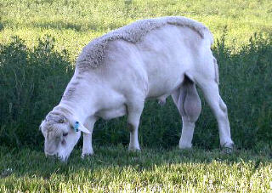

Slide 11
Flushing
Fertility of the ewes is greatly influenced by her diet and nutritional state.
The ewe should be gaining weight up to and during mating and should maintain this condition while the ram is with the flock (six to eight weeks)
This is achieved by Flushing.
Flushing constitutes moving the sheep onto rich pasture two weeks prior to mating.
Good after - grass is very suitable for this.

Slide 12
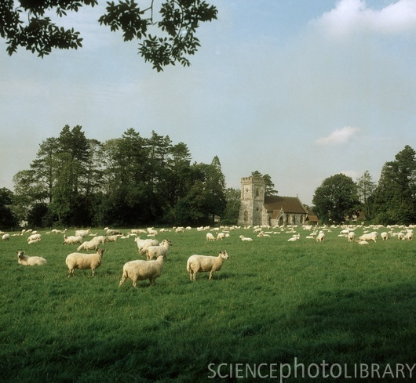

Slide 13
Flushing - 2
If good grass is not available then concentrates will be required.
Flushing affects fertility in a number of ways:
It increases ovary activity to result in more heat periods.
It causes multiple ovulations (twins and triplets)
Ewes that had lambs the previous year should be “slimmed down” after weaning (Put on poor pasture or densely stocked) Why?
If they are not reduced in this way then they may be too fat at mating time or may not be able to put on the weight during the critical period.

Slide 14
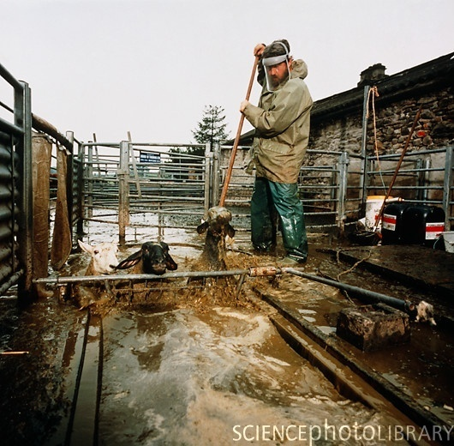

Slide 15
Before Mating
Two weeks before mating the sheep should receive their winter dip (not before 15th September)
Otherwise the sheep can receive the dip a few weeks after mating.
The whole flock should be dosed for intestinal parasites (worms).
The wool around the tail should be trimmed to facilitate service and avoid injury to the ram.

Slide 16
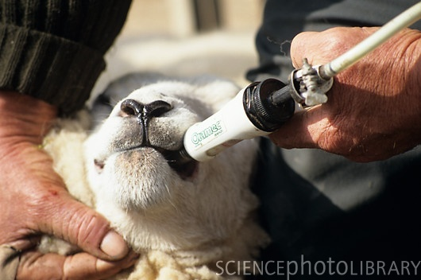

Slide 17
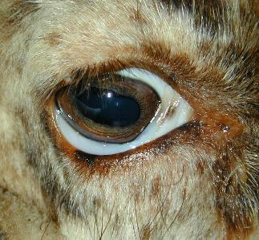
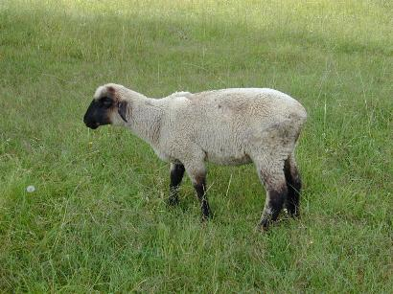

Slide 18
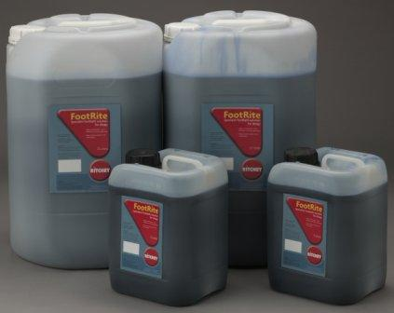
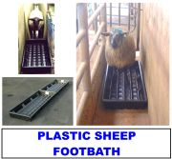
Before Mating - 2
All ewes should have their udders checked for hardened lumps with serious cases being culled.
The whole flock should be walked through a FOOTBATH to prevent footrot trouble. Affected animals should be properly taken care of.
Flushing two weeks before joined by the ram.

Slide 19
Synchronised Breeding / Breeding out of Season
A ewe's reproductive activity is controlled by photoperiod (the number of hours of daylight).
In temperate climates, when day length becomes shorter and temperatures become cooler, this change triggers the ewe's brain to release hormones to begin the reproductive process.
Synchronised Breeding allows all your lambs being born around the same time.
Synchronised breeding also allows for lambs to be born earlier than normal as heat can be induced!
Earlier lambs would be available for the Easter market and would get a better price.

Slide 20
Synchronised Breeding - 2
Synchronised breeding is carried out by “sponging”.
Sponging is a process whereby a hormone impregnated sponge is inserted into the ewes vagina.
When the farmer wants to induce heat, the sponge is removed and the animal is injected with PMSG
If all the ewes are sponged, then all the lambs could be born within a few days of each other.
This does mean that the farmer will have more work in a short period of time!

Slide 21
Oestrous & Pregnancy
During their fertile period, ewes will come into oestrus (heat) every 17 days until they are bred or their fertile period is over.
Only during oestrus will a ewe allow a ram to mate with her.
The duration of oestrus is 24 to 36 hours.
The gestation period of sheep is 5 months less 5 days!
Since ewes are only pregnant for five months, it is possible for ewes to give birth to lambs at an interval of every six to eight months.
However, annual lambing (every 12 months) is most common.

Slide 22
Oestrous & Pregnancy - 2
Ewes usually give birth to 1 to 3 lambs at each birth.
Twin births (two babies) is most common in well-managed flocks, though first time mothers are more likely to have single lambs.
Ewes produce their largest litters of lambs when they are between 3 and 6 years of age.
Lambs are usually 5kg in weight when born, but twins may be only 3.5 kg.

Slide 23
Mating
The ram should be in good forward condition but not fat. Why?
Fatness reduces activity and fertility while poor condition may leave him weak and emaciated at the end of mating.
Raddling
Rams should be raddled daily with a suitable marker or a marker harness fitted. WHY?
So that served ewes can be separated.
To check for ram fertility i.e. repeat services.

Slide 24
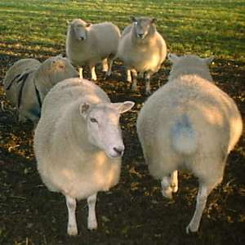
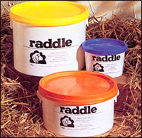

Slide 25
Mating -2
The rams may need to be hand fed as they would generally not eat much during mating.
After mating (six to eight weeks) the ram is removed from the ewes and placed in a separate paddock with the other rams.
He must gain weight before the onset of winter.

Slide 26
Note: Mating Ewe Lambs
Ewe Lambs are lambs that are 1 year old and are being served for the first time.
Ewe lambs can be served in their first year provide the weigh 50kg at mating time.
It is advisable to put all the ewe lambs in one paddock with a ram to themselves.
The ram should be mature and definitely not a ram lamb.

Slide 27
After Mating
The foetus grows very slowly during the first three months or pregnancy so the feed requirements are generally low but good feeding should be maintained for the first six weeks.
The feeding over the second six weeks can be reduced slightly
Look out for foot problems.
Administer winter dip if not already carried out.

Slide 28
Late Pregnancy
During the last two months of pregnancy, the unborn foetus grows very rapidly and the ewe’s udder development increases accordingly before the onset of lambing.
Because of this growth and development, the nutritional demands of the ewe increases also.
This is called STEAMING UP!
BUT there is a small problem.
Because the foetus is growing so rapidly inside the ewe, there is little room available for the digestive system of the sheep.

Slide 29
Late Pregnancy - 2
The answer is a more concentrated diet.
Fodder beet or turnips are useful or the use of meals and nuts.
Six weeks before lambing, the meals should be introduced, 250g a day at first and gradually increased to 750g a day.
Ewes with twins should be fed more accordingly.
There is a scanning technique to determine whether or not a ewe is carrying twins.

Slide 30
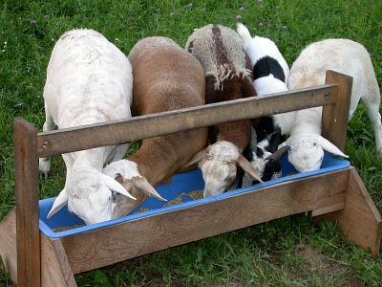

Slide 31
Late Pregnancy - 3
What happens if ewes are under fed??
Serious problems occur if the ewe is underfed.
Twin lamb disease, which can prove fatal for the ewe and lambs.
Too much feeding can also prove problematic. How?

Slide 32
Late Pregnancy - 4
Over fat ewes can also develop twin lamb syndrome and over feeding can also cause the foetus to grow too quickly and cause lambing problems.
Ideally, the ewe should be of good size and have enough nutritional reserves (steaming up) to ensure enough milk is available for her lambs.

Slide 33
Care Before Lambing
Two weeks before lambing the ewe receives a “seven in one” or “eight in one” booster injection against clostridial diseases.
The ewes should again dosed for intestinal parasites (worms)
The wool around the tail should be removed or trimmed.
In addition the wool around the udder should be trimmed.

