Slide 1
Leaving Certificate Agricultural Science
Pig Production

Slide 2
Learning Outcomes
In this unit you will learn about
Breeds of Pig and their Characteristics.
Dental Formula
Gestation period, oestrous cycle (duration & length)
Target weights.
The management of a bonham from birth to slaughter.
The management of the dry and in young sow.
Diseases of pigs

Slide 3
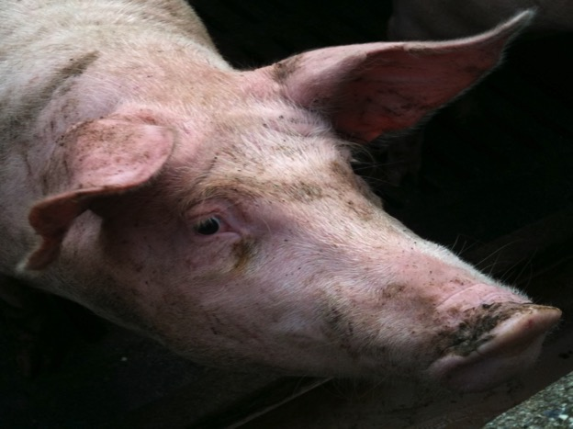
Pig Facts
1.5 million pigs in Ireland
Thats 0.2% of world pig Population.
941.2 Million Pigs World Wide
Products:
Bacon
Pork
Leather, etc

Slide 4
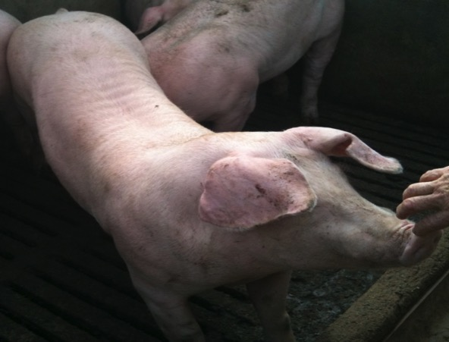
Breeds of Pigs- Landrace
Good Conformation
Long body
Floppy Ears
Yield valuable back bacon & Pork, small shoulders & large hams.

Slide 5
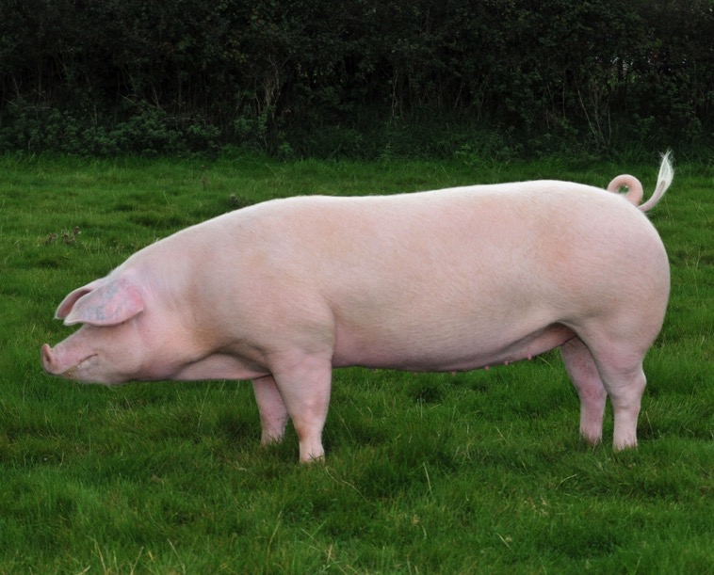
Landrace

Slide 6
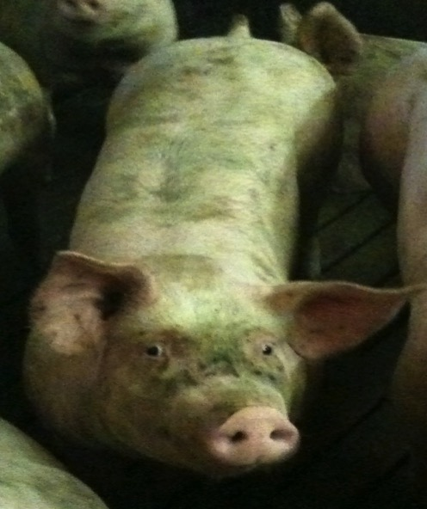
The Large White
British Origin
Fast Growth Rate
High Prolificy
Good Food Conversion Ratio
Good Meat Quality
Erect Ears

Slide 7
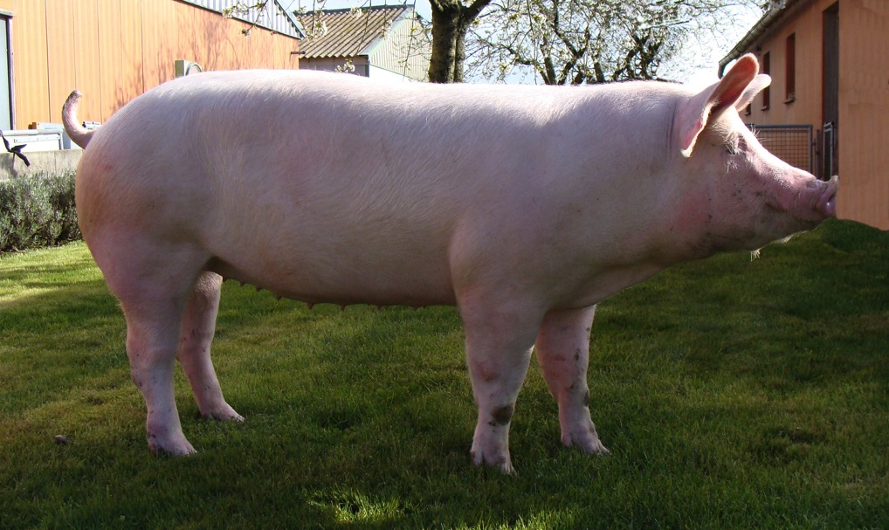
Large White

Slide 8
Outdoor Pig Breeds
Most pigs in Ireland are raised indoors but on some farms they are raised outside.
The Landrace and Large White are not suitable for outdoor pig farming.
Outdoor pig breeds include:
The Duroc
The Saddleback
Gloucestor Old Spot
Tamworth
Piétrain

Slide 9
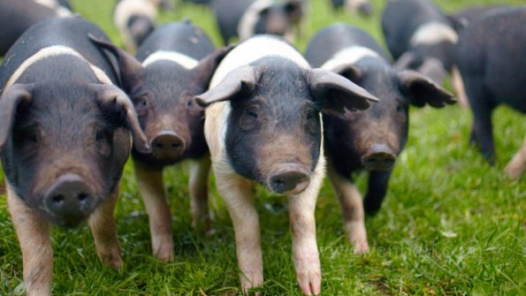
Saddleback

Slide 10
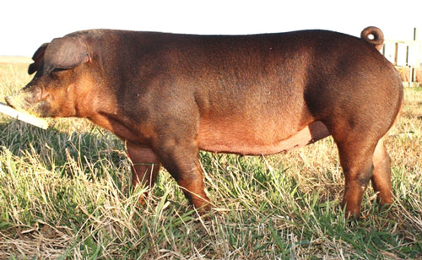
Duroc

Slide 11
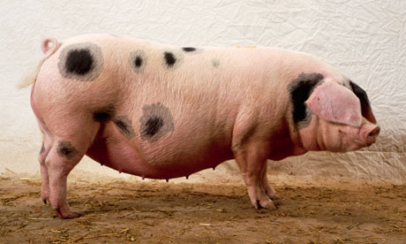
Gloucestor Old Spot

Slide 12
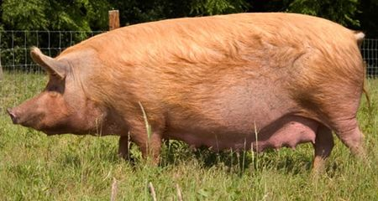
Tamworth

Slide 13
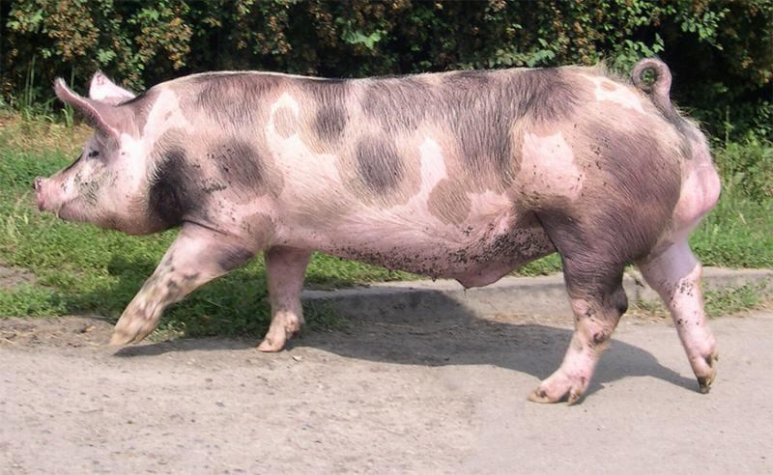
Piétrain

Slide 14
PIG FACTS
Monogastric
Bonhams weighs 1.0 – 1.5 kg at birth.
Average litter size is 11.
Bonhams reach slaughter weight of 82kg in 6 mths. (reared indoors)
Both sexes reach puberty at 6 months
Fully mature pigs weigh 140-200kg
Even toe ungulates
Phylum Chordata

Slide 15
Gestation & Oestrous
Gestation Period114 days (3 months, 3 Weeks, 3 Days)
Oestrous cycle is 21 days
Lasts 2-3 days

Slide 16
DENTAL FORMULA- PIG
Incisors, Canines, Premolars, Molars.
3 1 4 3
3 1 4 3
X 2

Slide 17
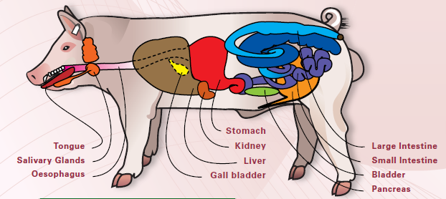

Slide 18
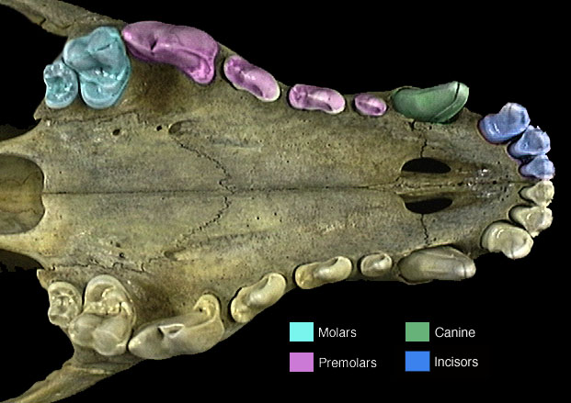

Slide 19
Learning Check....
Name 2 pig breeds and state their charectoristcs.
What is the average weight at birth of a bonham?
What is the gestation period of a sow?
What is the length of the oestrous of a sow?
How long does it last?
What is the average litter size?

Slide 20
Food Conversion Ratio
Is the ratio of food consumed to live weight gained.
An FCR of 2 means that for every 2kg of food eaten an animal gains 1kg of live weight.
Low FCR means good feed efficiency
80% of costs are attributed to feed costs
Aim FCR 1.75 weaners
Aim FCR 3.25 for fatteners

Slide 21
Factors Affecting FCR
Breed – boars can confer low FCR values to their offspring.
Health- only healthy pigs can fully achieve their potential to utilise feed efficiently
Housing – it is important to reduce heat loss so as the pig can use the food to put on flesh rather than trying to maintain constant temp. Well insulated houses. Infa –red lamps
Diet- range of rationed suited to bonhams, weaners & fatteners. Rations should balanced quantities of energy, protein, minerals & vitamins. Amount of Essential Amino Acids
Management skills of farmers

Slide 22
Criss-Cross breeding
Sire | Dam | Progeny | Use of Progeny
LR | LW x LR | LR x (LW x LR) | All males and most females fattened Selected females often kept for breeding
LW | LR x (LW x LR) | LW x (LR x LW x LR) | All males and most females fattened Selected females often kept for breeding
LR | LW x (LR x LW x LR) | LR x (LW x LR x LW x LR) | All males and most females fattened Selected females often kept for breeding

Slide 23
Criss-Cross breeding
Small numbers of purebred boars of each breed are kept
Boars are mated alternatively with crossbred sows
Maintain hybrid vigour
Boars replaced every two years to prevent inbreeding
Animals that are produced are very suitable for fattening

Slide 24
Leaning Check....
What do the letters FCR stand for?
List 5 factors that affect FCR.
Describe Criss-Cross Breeding.
What is meant by hybrid Vigour?

Slide 25
Types of Production units
Integrated Pig Production Units
consist of a (A) breeding and rearing unit with its herd of sows with accompanying bonhams (B) a fattening unit used to bring pigs from weaning to slaughter weights.
They are self contained- this lessens the risk of disease entry & eliminates transport stresses on pigs
Outdoor Pig Production
Smaller scale. Animals move between indoor space and grassland (which they dig up).
Higher level of disease and lower growth rate,

Slide 26
Pig Production In IPU’s
Sow has to produce at least 2 litters a year
20 weaners
In Young Sow
She is housed in a dry sow house
Fed once per day(2.5kg)
In early pregnancy some sows are over thin because they have reared a big litter- these have to be given extra feeding to bring them to proper weight
In the final 3-4 weeks sows are fed an extra 0.5kg/day to ensure strong healthy bonhams & good milk production
A week before farrowing date the sow is moved to the farrowing unit.

Slide 27
Dry sow house

Slide 28
Farrowing Unit
Where litter is born.
Stays there for 4-7 weeks.
The sow is washed, deloused & disinfected and put in a clean disinfected farrowing unit about 1 week prior to farrowing date.
The house is maintained at a temperature of 20ºC.
It is draught free
Infra red lamp
She must be observed to insures she farrows without difficulty

Slide 29
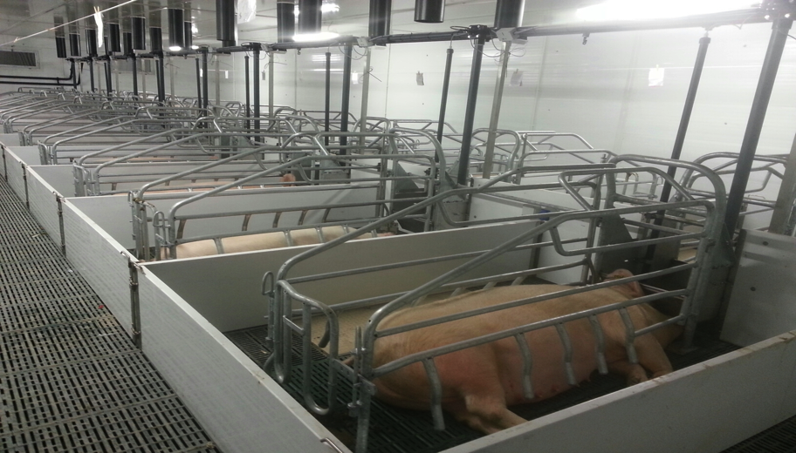

Slide 30
Farrowing
Veterinary assistance should be obtained if problems arise
Farrowing crate is designed to allow the sow to farrow with minimum risk to the bonhams. Stand up- access to for suckling & Infa red lamp.
It takes about 20 minutes per bonhams to farrow.
The bonham amazing selects a teat when born and sucles that teat for the remaining time.

Slide 31
Suckling Period
Immediately after birth bonhams front teeth are broken off to protect the sows teats from injury.
2 -3 days after birth they are injected with iron to prevent anaemia
The bonhams suckle for 5 -6 weeks. The sow is fed suckling ration at a rate of 1.8kg + 0.5kg /bonham/day.
The sow only has enough milk for 30 days.
After 5 -7 days creep ration is scattered on the floor
Separate supplies of water are given

Slide 32
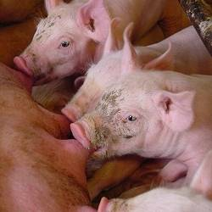
Suckling

Slide 33
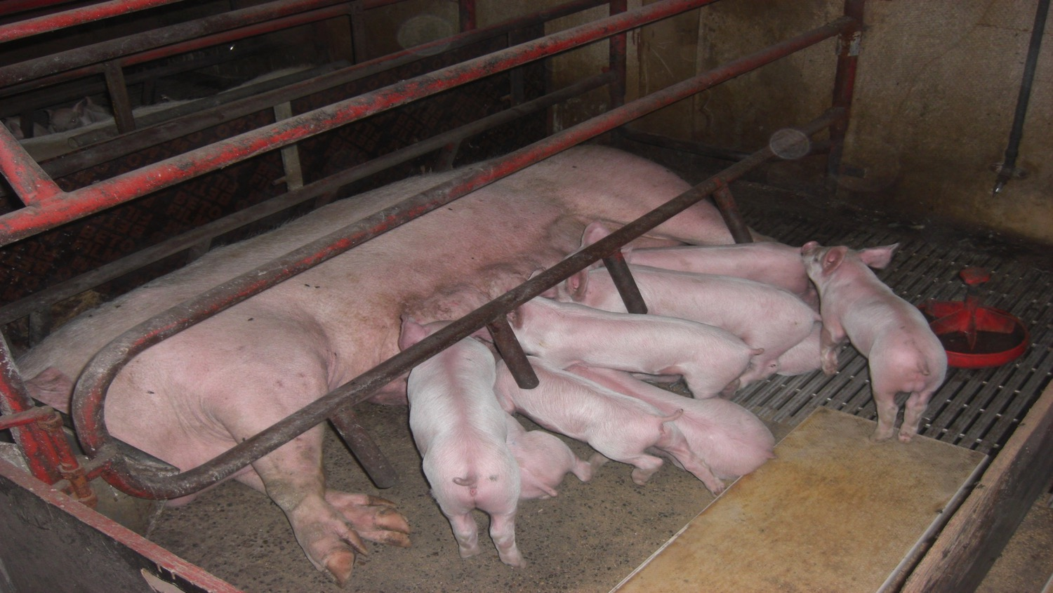
Farrowing House

Slide 34
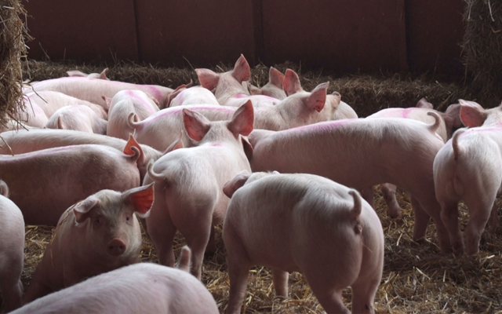
Tail Docking & Castration
Bonhams tails are cut off at day 3..
Prevents them biting their tails due to boredom.
Bonhams are castrated only if they are being slaughter at an older age. This prevents meat Taint..

Slide 35
Learning Check....
What happens in the farrowing unit?
Where are the in young sows prior to farrowing?
Explain why the following are carried out?
Injected with Iron
Tails cut off
Teeth Broken
Placed under an infa red lamp
Explain their feeding regime.
What is meant by an integrated system?

Slide 36
Post Weaning Sow Management
After weaning, the sow is moved back to the dry sow house.
She comes back into oestrous within 5-7 days of weaning.
A boar is released once a day to detect sows heat.
When detected, sow is removed and served by appropriate boar/AI twice within 24 days.
Double servicing increases conception rates & litter sizes.
If comes back into oestrous in 21 days, serviced again.
Sows are culled at 4-5 years old or when health declines.

Slide 37
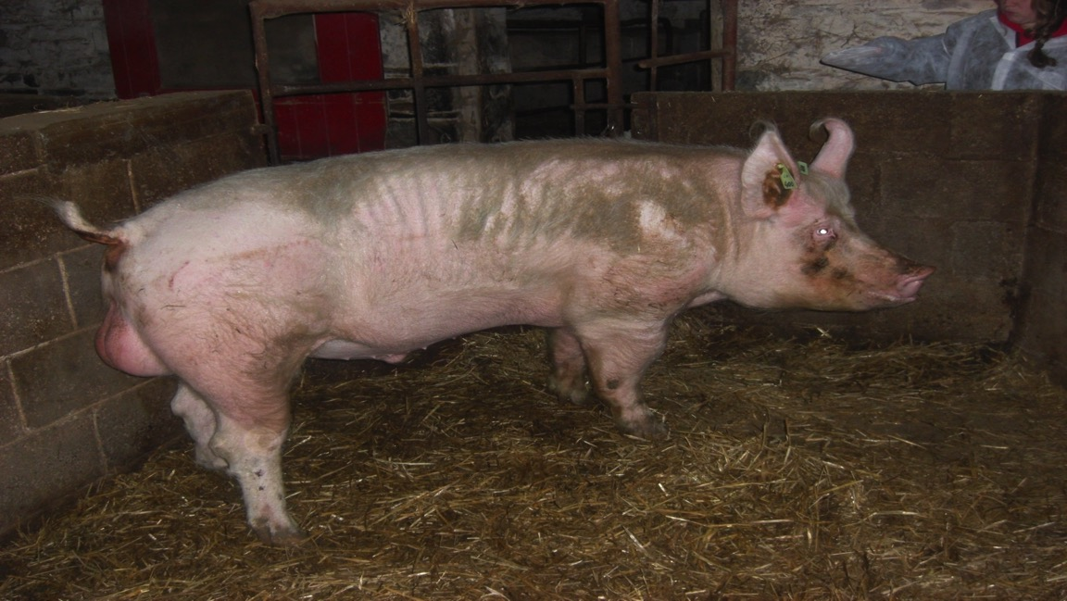
The Boar

Slide 38
Boar close to sow

Slide 39
Fresh Pig Semen for AI

Slide 40
In heat Sow.
When the sow is in heat she remains very still with ears erect and close together.

Slide 41
Management & Feeding of Weaners
Bonhams are weaned abruptly at 5-6 weeks
Those of same weight are placed in groups.
These groups are moved to weaner houses.
They are stocked at sufficiently high density to allow house temp. to be at 24ºC.
Houses have under floor insulating & low roofs to conserve heat.
Weaners are fed weaner ration ad lib & water is available.
Weaning weight increases from 9kg to 32kg
Stocking density has to be re-evaluated to avoid over crowding

Slide 42
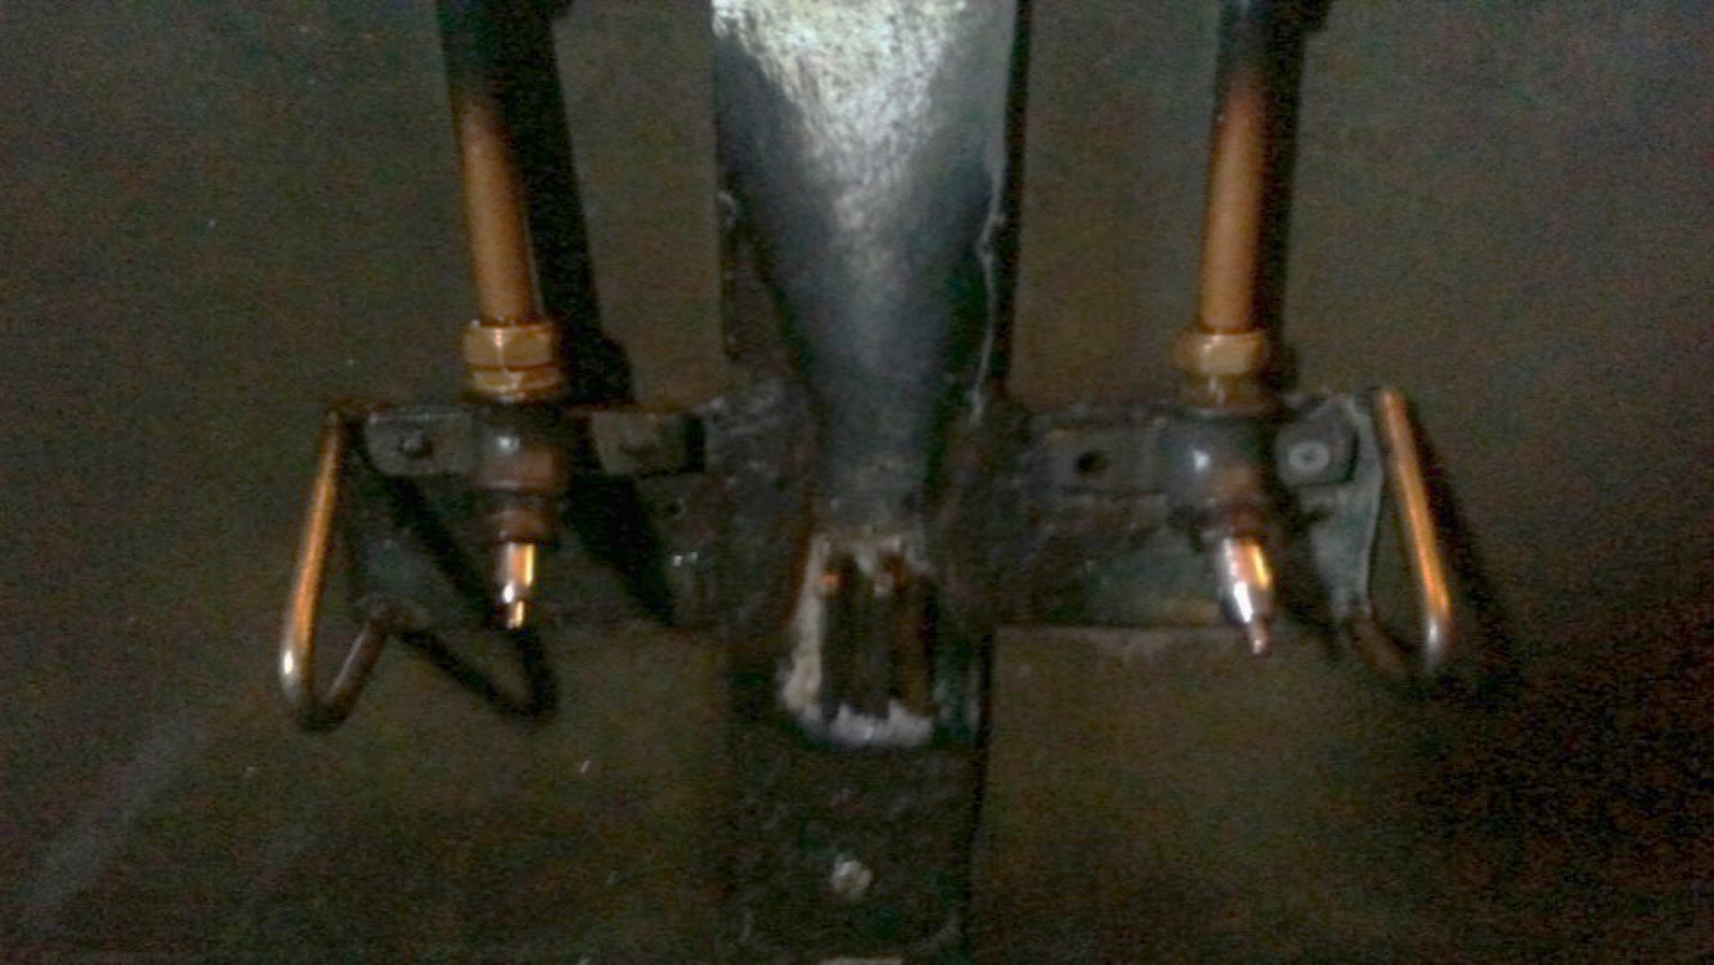
Water Supply

Slide 43
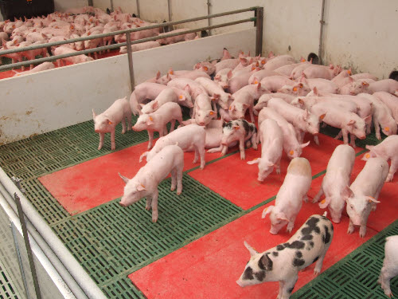
The Weaner House

Slide 44
Learning Check....
At what weight are bonhams weaned at?
What age are bonhams when they are weaned?
How is it carried out?
State the feeding regime for a weaner.
Describe the term Double servicing

Slide 45
Management & Feeding Fatteners
When weaners are moved to fattening houses, they are again mixed according to size.
This is the last house before slaughter.
They are stocked at a density (lower) required to maintain the correct temperature 22ºC.
Room to walk around.
Fattening houses have low roofs and very good insulation.

Slide 46
Fatteners
Fattener ration is fed ad lib. 15% protein.
Water is available.
Many producers restrict feeding for the last few weeks prior to slaughter to restrict fat deposition & improve carcase grade.
Sent for slaughter when weigh 82kg or when they have the degree of finish required for factory.
Farmers assess it visually or by use of ultrasonic devices.

Slide 47
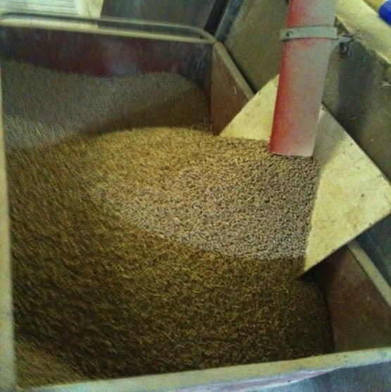
Fatteners & Fattener Ration

Slide 48
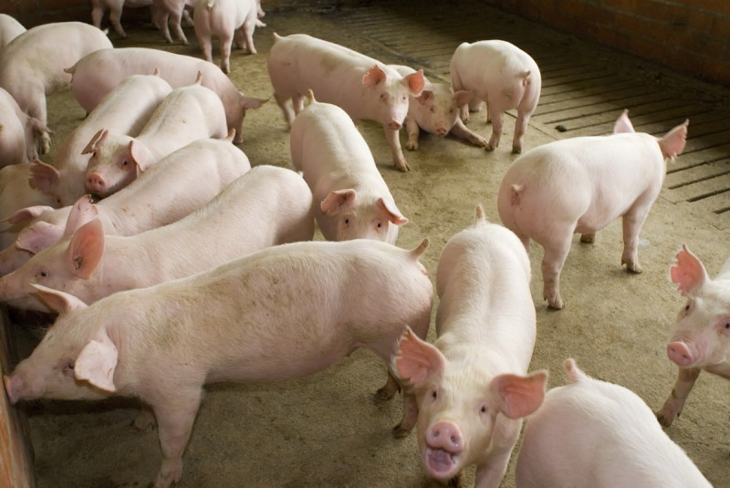
Fattener House

Slide 49
Condition Scoring
Condition scoring is carried out by farmers to assess if an animal is ready for slaughter or fit for mating.
It is carried out by running a hand along the rib cage and back bone to assess the level of fat cover.
In a scale of 0 to 9, 0 is extremely thin and 9 is extremely fat. Scores in the middle are most desirable.
It is very subjective and requires a lot of experience.
It is on a scale of 0-5 for cows and sheep.

Slide 50
Learning Check....
What is meant by Critical Temperature?
What are the critical temperatures in the farrowing Unit, the weaner house and the fattening house?
Name the house that fatteners are kept in.
State the feeding requirements for fatteners.
At what weight are fatteners slaughtered at?
What is condition scoring and what is the best condition score for a fattener?

Slide 51
Replacement Gilts
Gilts are female pigs which have not yet had their first litter selected at birth for their excellent conformation and breeding.
As fatteners approach slaughter weight those with the best conformation & health are selected as breeding herd replacements.
They are housed together for a further 4-6 weeks before being moved to dry sow house.
They will come into oestrous and enter the production cycle.

Slide 52
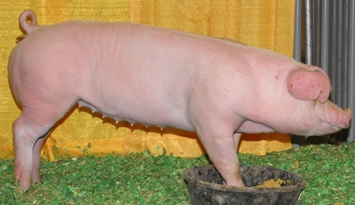
Replacement Gilt

Slide 53
Gilt – Ear Notching
Notched ear means that this pig has been selected at birth for breeding purposes by the farmer.

Slide 54
Diet of Monogastric v Ruminant
Non –ruminant
Non-roughage
Balanced ration – high protein, vitamin A, D & minerals (iron)
Housed in doors, therefore lacking minerals from the soil.
Wide variety of materials in ration to make up concentrated ration
Ruminant
Roughage
Grazed out doors- grass- high quality grass =complete food
Less variety of materials in ration

Slide 55
Diseases of Pigs
Commercially reared and fattened indoor pigs are subject to a much less number of diseases than cattle or sheep.
Reasons : 1. Pigs live in a controlled environment with little or no contact with soil or vegetation. 2. temp, humidity, hygiene & diet are all controlled and kept at levels optimum for growth & development.3. Usually self contained except for occasional purchases of boars
The controlled environment can grow and spread disease rapidly. Hygiene is crucial. Disinfectant baths.

