Slide 1
Sheep 1
Leaving Certificate Agricultural Science
Breeds & Breeding Principles

Slide 2
Learning Outcomes
At the end of this section you should be able to:
Distinguish between lowland and hill / mountain sheep farming.
Briefly describe why sheep can be a profitable enterprise.
Describe the classification of sheep breeds, understanding the terms carcass, prolific and terminal sire.
Identify and briefly describe the physical features of the main sheep breeds used in Ireland.

Slide 3
Introduction to the Sheep Industry
There are two distinct types of sheep farming in Ireland - hill/mountain sheep farming and lowland sheep farming.
And there is a lot of crossover between the two systems as hill farmers trade freely with lowland farmers.
The sheep industry relies on cross-breeding to produce good quality meat animals.
Cross-bred ewes account for 40% of the national flock.
Hill lambs are often sold to the lowlands to be "finished" (fattened for meat).

Slide 4
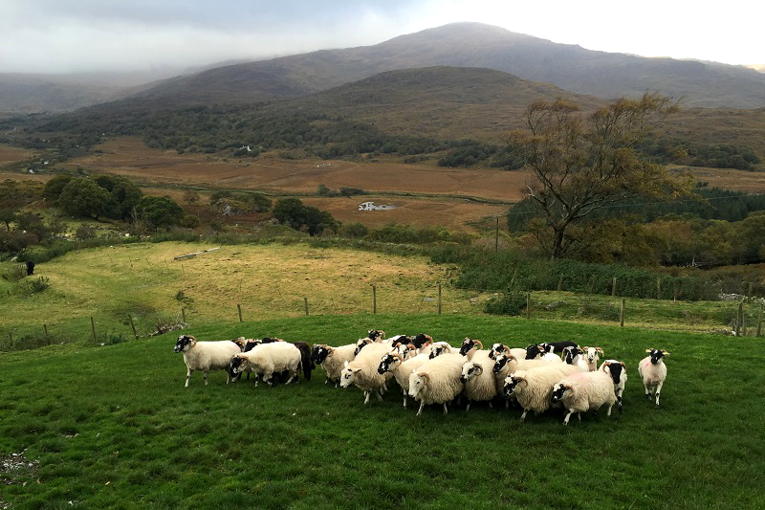

Slide 5
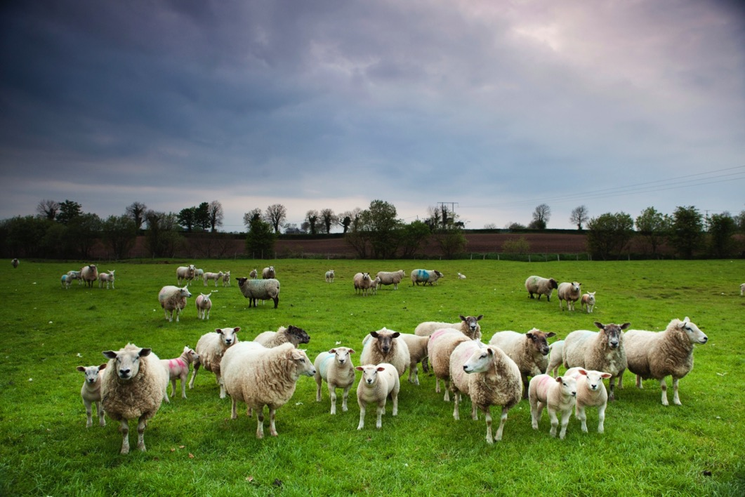

Slide 6
Introduction to the Sheep Industry - 2
Hill farming
Hill farming is a system of farming found in mountainous areas.
Sheep have access to wide areas of upland grazing, with few enclosures or fences.
The breeds are hardy and, by comparison with lowland breeds, they are often more lightly built.
They are accustomed to rough terrain and a harsh climate.
Lowland sheep farming
The lowland sheep farmer rears sheep in enclosed lowland pastures, often on fairly fertile ground.
Some of the typical lowland sheep breeds that are used in Ireland are heavier than their athletic hill cousins.
They have been bred to lamb early, to produce fast-maturing lambs and sizeable, lean carcasses.

Slide 7
Introduction to the Sheep Industry - 3
Why are sheep profitable?
Sheep can survive on both mountain and lowland areas.
They can utilise herbage that other animals cannot. E.g. Heather
They can climb to areas where other animals cannot gain access.
On lowland farms, where Cattle and Sheep are grazed together, meat output per hectare is significantly higher than if they were grazed separately. Why?
Because sheep can control weeds in pastures as they graze herbage that cattle would not.

Slide 8
Classification of Sheep
The Ewe Breeds
The female of these breeds are able to produce good quality carcases when crossed with a quality ram.
Examples include Galway, Blackface Mountain and the Cheviot.
The Prolific Breeds
Ram breeds who give significantly more offspring than the Galway or other Ewe Breeds.
Examples are the Border Leicester, the Belclare Improver and the Blue Faced Leicester.

Slide 9
Classification of Sheep - 2
The Carcase Breeds
Include the Suffolk, Down Breeds and the Texel.
These are again Ram Breeds, which impart superior carcase qualities on their offspring.
They are also known as TERMINAL SIRES.
Terminal sires are lowland breed of ram, which is used to mate with crossbred ewes, to produce a decent lambs
The Cross Breeds
Do not include mongrels. The result of systemised cross breeding policies to produce offspring baring all the best qualities.
They usually involve a prolific sire and an indigenous (normal) ewe.

Slide 10
Examples of Cross Breeds
Blackface x Border Leicester = Greyface
Blackface x Blue faced Leicester = Scotch Mule
Cheviot x Border Leicester = Half-breed
Galway x Belclare Improver = Improved Galway

Slide 11
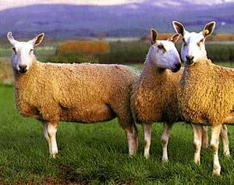
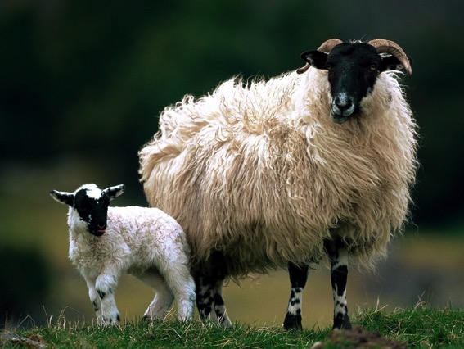
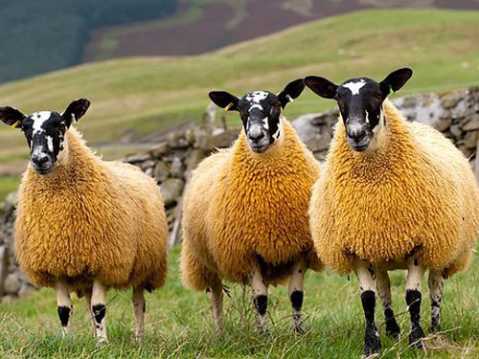

Slide 12
The Main Sheep Breeds
The Galway
Big, late maturing “Long Wool” Sheep.
Pure breed Galways are sold for Store Production as HOGGETS between Xmas and Easter of their first year.
When crossed with Suffolk the offspring then mature early.
Galway is a large, polled, white-faced breed noted for:
Prolificacy - The best managed flocks can achieve 200% lambing
Longevity – Can lamb up to 10 years old.
Moderate growth rate and ease of finishing
Excellent carcase & eating quality
Fine quality wool
Hardiness & ease of management

Slide 13
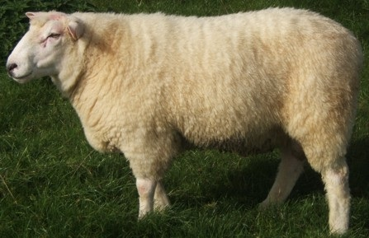

Slide 14
The Main Sheep Breeds
The Blackface Mountain
All Blackfaces are horned, with black or black and white face and legs.
Sometimes known as Scotch Blackface, Kerry Sheep or just “Blackies”.
They are very hardy and thrive in harsh & exposed conditions.
Low lambing rate! Why?
Blackface ewes are excellent mothers.
They are good milkers and are able to yield a lamb crop and a wool clip even when on marginal pastures
When brought down to lowland farms, Blackface ewes become prolific dams (female).

Slide 15
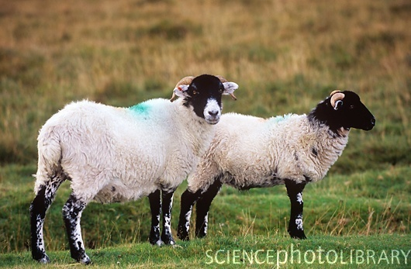

Slide 16
The Main Sheep Breeds
The Wicklow Cheviot
The cheviot is hardy, fairly prolific and a good mother.
Their feet are sound and not prone to foot rot
The cheviot produces ideal lambs for the French market.
Good quality fleece of wool.
More so a hill breed and not quite as hardy as the Blackface.
Usually crossed with a prolific breed for production of commercial breeding ewes.
Lambs from a suffolk ram are good quality and early maturing.

Slide 17
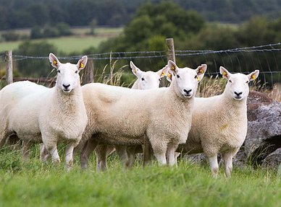

Slide 18
The Main Sheep Breeds
The Suffolk
The Suffolk is a hornless or polled breed, with a distinctive all-black head and black legs, and close-cropped white wool.
It is a dual-purpose breed for both meat production and wool.
But today it is the most commonly used sire for cross-bred lambs for meat.
A mature ewe can weigh 84 kg and a ram can reach 130 kg.
Very popular ram for production of fat lambs.
Impart excellent carcase characteristics to their offspring.
Important for early lamb production (born at Xmas and sold at Easter)

Slide 19
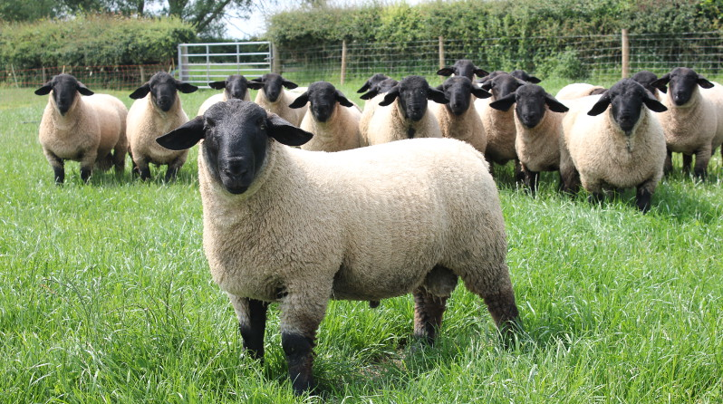

Slide 20
The Main Sheep Breeds
The Texel
Originate from an island off the coast of Holland.
Introduced to Ireland in the 1960’s and 70’s.
The Texel is a white, hornless breed with crinkly wool and a very square stance.
The Texel is a hardy sheep that is capable of withstanding harsh winters.
Pure Texel and Texel cross lambs will suckle hard for milk as soon as they are born.
A mature ewe can weigh 85 kg and a ram 120 kg.
Low prolificacy but known better as a TERMINAL SIRE.
Very low lean to fat percentage.

Slide 21
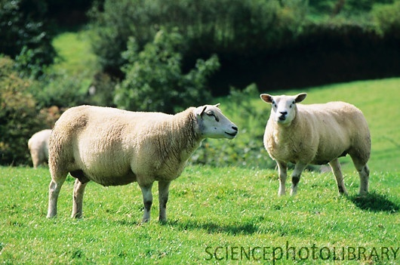

Slide 22
The Main Sheep Breeds
The Belclare Improver
A breed developed by Scientists in the AFT Institute in Co. Galway.
Made up from three lines of breeds.
The Belclare are polled, white in colour with a good fleece, very sound feet and minimum mastitis problems.
Ewes are docile, have excellent mothering ability with a minimum of lambing difficulty and are capable of rearing three lambs if given adequate feed during lactation.
Daughters of your own ewe flock, sired by a Belclare ram are capable of increasing lambing rates by up to 30

Slide 23
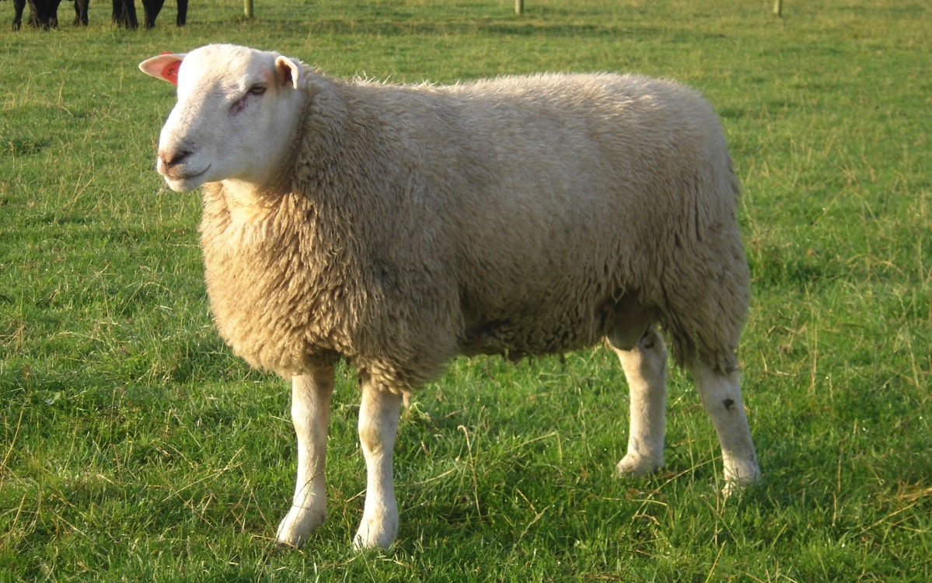

Slide 24
Other Sheep Breeds
Other sheep breeds include:
The Beltex
Charollais
Dorset
Norfolk
Zwartbles

Slide 25
